Slide 1

CSET 105
Network Design and Management
Evening Masters Edition
Dr. Mahboob Qaosar
Associate Professor, CSE, RU

Slide 2
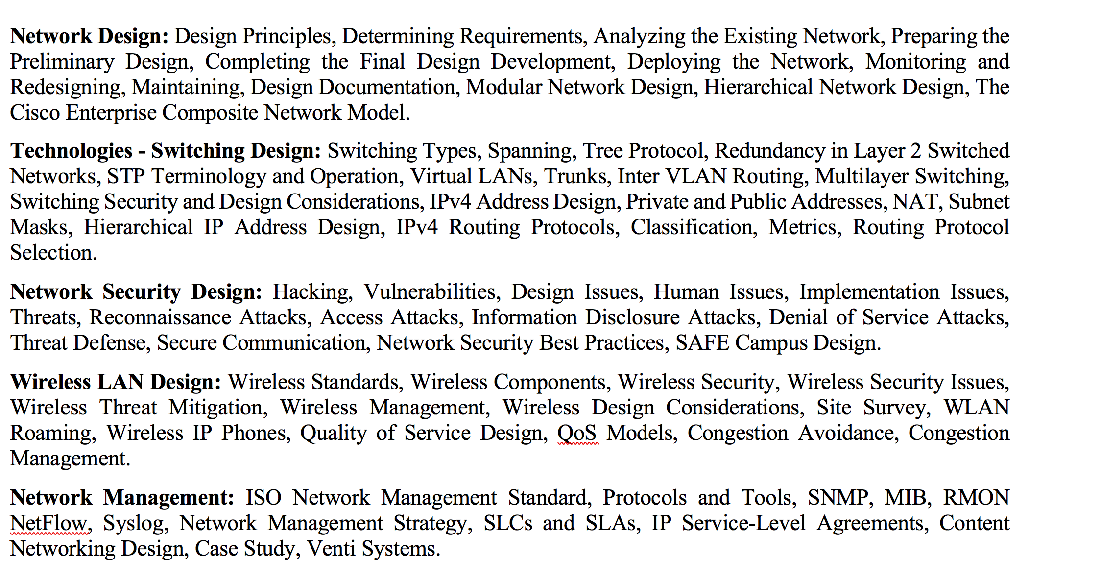
Course Contents

Slide 3
Network Security
Hacking
Most of us equate hacking with malicious (nasty or cruel) activities
Reality: hacking is defined as working diligently (carefully) on a computer system until it performs optimally.
Right now hacking is more related to cracking,
Cracking ⇨ which is defined as the act of unlawfully accessing a network infrastructure to perform unethical activities.
hacking denotes malicious activities directed at networks and systems.

Slide 4
Types of Hacker
There are as many motivating factors for hacking as there are hacker types.
From the script-kiddy who downloads hacking shareware and follows on-screen instructions to the cyber-terrorist, one thing is certain: They want to inflict pain on your organization.
Also, although they are not necessarily qualifying as hackers, careless employees can also be dangerous to your organization.

Slide 5
Types of Hacker
Types of Hacker
White Hat Hacker
Black Hat Hacker
Grey Hat Hacker
Elite Hacker
Script Kiddiy

Slide 6
Types of Hacker
White-Hat Hackers
Not all hackers spell trouble.
White-hat hackers are either reformed hackers or network professionals who have achieved mastery of the art and science of hacking.
White-hat hackers are paid to provide penetration testing of the corporate network and to produce a detailed report of their findings.

Slide 7
Types of Hacker
Black-Hat Hackers - Alternative
White-Box and Black-Box Hacking
White-box hackers are provided with some design and knowledge of an organization's network infrastructure prior to attempting their hacks of the system.
Black-box hackers have no prior knowledge of the network before attempting to hack it.

Slide 8
Vulnerabilities
Vulnerabilities ⇨ Vulnerability ⇨ weakness
Regardless of whether the hacking motivation is benevolence, carelessness, or maliciousness, hackers wouldn't exist if vulnerabilities weren't available to exploit.
Vulnerabilities usually fall into one of the following categories:
Design issues
Human issues
Implementation issues

Slide 9
Vulnerabilities
Design Issues
Design issues refer to inherent problems with functionality because of operating system, application, or protocol flaws.
Human Issues
The human issues category of vulnerabilities refers to administrator and user errors, such as unsecured user accounts, unsecured devices, or open devices (devices that have not been hardened).
Implementation Issues
Implementation issues deal with creation, configuration, and enforcement of security policies, such as password policies, remote-access policies, Internet usage policies, e-mail policies, and so on.

Slide 10
Threats
Threat ⇨ risk
The following is a generic list of attack categories:
Reconnaissance attacks
Access attacks
Information disclosure attacks
Denial of Service Attacks
Notes:
রিকনাসেন্স

Slide 11
Reconnaissance Attacks
Reconnaissance – investigation
Reconnaissance attacks consist of intelligence gathering, often using tools like network scanners or packet analyzers.
The information collected can then be used to compromise networks.
Such as:
Ping sweeping
To discover network addresses of live hosts

Slide 12
Reconnaissance Attacks
Network and port scanning
To discover active ports on target hosts
Stack fingerprinting
To determine the target operating system (OS) and the applications running on targeted hosts
Enumeration (meaning list)
To infer network topology

Slide 13
Threats
Threat ⇨ risk
The following is a generic list of attack categories:
Reconnaissance attacks
Access attacks
Information disclosure attacks
Denial of Service Attacks
Notes:
রিকনাসেন্স

Slide 14
Access Attacks
During an access attack, the hacker exploits the vulnerabilities he has discovered during the reconnaissance attack.
Some common access attacks are as follows:
Entry ⇨Unlawful entry to an e-mail account or database.

Slide 15
Access Attacks
Collect ⇨The hacker gathers information or passwords.
Plant ⇨ The hacker might create a back door so that he can return at a later time.
Occupy ⇨ The hacker might elect to control as many hosts as he wants.
Cover ⇨ The hacker might cover his tracks by attempting to change the system logs.

Slide 16
Access Attacks
Access Subterfuges (trick)
Hackers continuously come up with crafty (cleverly) access attacks.
The originator could be a spammer who plans to use this information for future spamming.
Proper dissemination and enforcement of an e-mail security policy would have taught the user not to open an attachment from an unknown source
Alternatively, the organization might have considered installing an e-mail filtering service to purge the message of executable attachments.

Slide 17
Threats
Threat ⇨ risk
The following is a generic list of attack categories:
Reconnaissance attacks
Access attacks
Information disclosure attacks
Denial of Service Attacks
Notes:
রিকনাসেন্স

Slide 18
Information Disclosure Attacks
Information disclosure attacks are different from an access attack in the sense that the information is provided voluntarily through a sophisticated subterfuge.
The following attacks, though considered information disclosure attacks, could fall into the category of white-collar crimes:
Social engineering
Phishing

Slide 19
Information Disclosure Attacks
Social Engineering
Social engineering, a form of low-tech hacking, is defined as someone, claiming to be someone he is not, who approaches a user either through e-mail or through a phone call for the purpose of infiltrating the organization. Great technical ability is not necessary to perform social engineering.
Phishing
Internet scammers who cast about for people's financial information have a new way to lure unsuspecting victims: they go phishing.
Phishing is a high-tech scam that uses spam or pop-up messages to deceive readers into disclosing credit card numbers, bank account information, Social Security numbers, passwords, or other sensitive information.

Slide 20
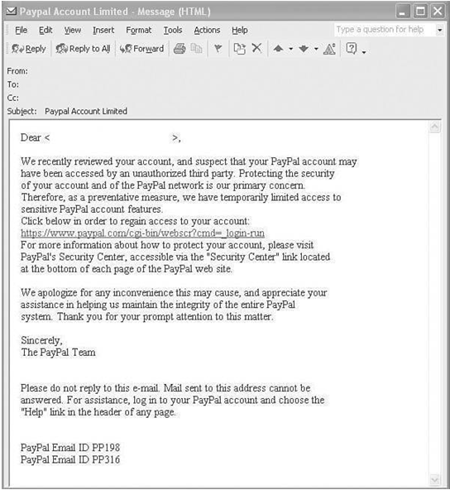
Example
Figure 4-1 is an example of an e-mail that looked legitimate but was actually a scam
Unfortunately, no security systems can protect against information disclosure. Only the dissemination and enforcement of sound security policies can help users learn to be suspicious and to confirm the origin of these e-mails prior to taking actions.

Slide 21
Denial of Service Attacks
With a DoS attack, a hacker attempts to render a network or an Internet resource, such as a web server, worthless to users.
A DoS attack typically achieves its goal by sending large amounts of repeated requests that paralyze the network or a server.
A common form of a DoS attack is a SYN flood, where the server is overwhelmed by embryonic connections.

Slide 22
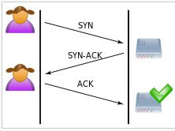
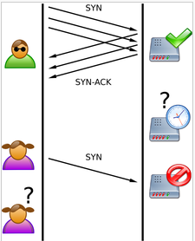
Denial of Service Attacks
A hacker sends to a server countless Transmission Control Protocol (TCP) synchronization attempts known as SYN requests.
The server answers each of those requests with a SYN ACK reply and allocates some of its computing resources to servicing this connection when it becomes a "full connection."
Connections are said to be embryonic or half-opened until the originator completes the three-way handshake with an ACK for each request originated.
A server that is inundated with half-opened connections soon runs out of resources to allocate to upcoming connection requests, thus the expression "denial of service attack

Slide 23
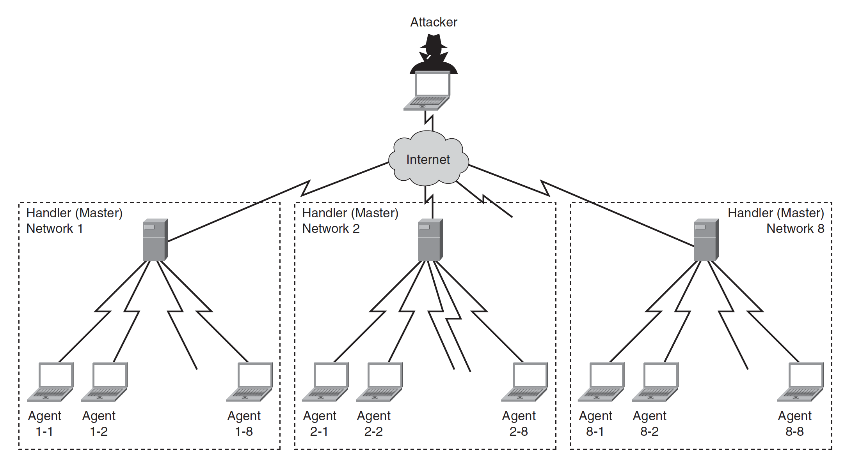
Distributed DoS Attack
DDoS agents. ⇨ referred to as bots, thus the expression of botnets.

Slide 24
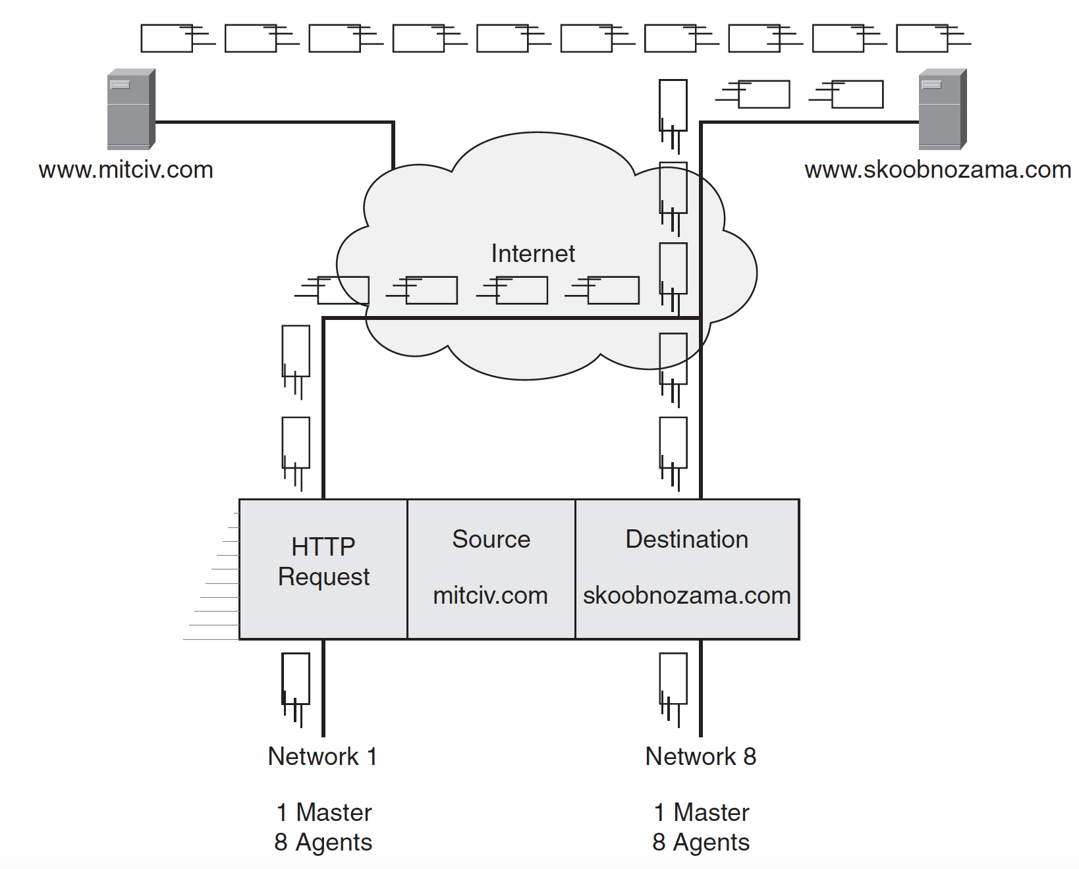
Distributed DoS Attack
The crafty hacker might have requested that the agents use a spoofed source IP address when sending the large quantities of packets to the destination

Slide 25
Mitigating Technologies
Known threats can usually be mitigated by security equipment and sound security policies.
The most pervasive mitigation techniques, which are grouped in these four major categories:
Threat defense
Secure communication
Trust and identity
Network security best practices

